Slide 1

Real Estate Sales Performance Report
Executive Summary Dashboard (2024–2026)
Prepared By:
Kamsi Chiadi (Data Analyst)
Tools: SQL Server, Power BI and Power Query

Slide 2
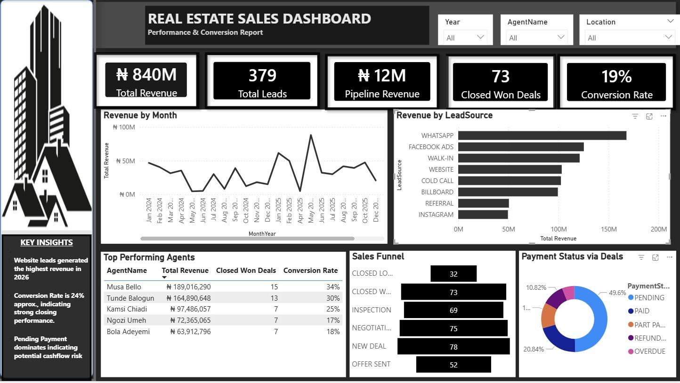
Total Revenue = 840 Million Naira
Total Leads = 379 Total Leads
Pipeline Revenue = 12 million Naira
Closed Won Deals = 73
Conversion Rate = 19%

Slide 3

KEY INSIGHTS
1. Lead Source Performance: WhatsApp generated the highest revenue, suggesting strong digital lead acquisition.
2. Sales Conversion: Conversion rate of 19% indicates moderate-to-strong closing efficiency.
3. Agent Performance: Top-performing agents contributed the majority of closed revenue, showing performance imbalance across the team.
4. Pipeline Health: Pipeline revenue shows potential growth, but deal drop-offs at negotiation indicate follow-up gaps.
5. Payment Risk: Pending payments dominate, indicating possible cash flow delays and customer payment issues.

Slide 4
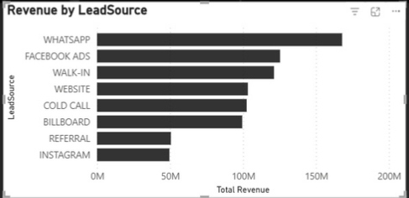
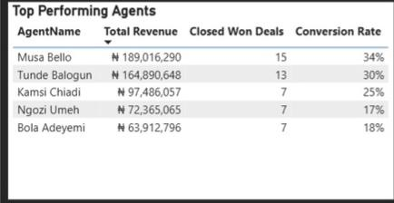
SALES FINDINGS
Best Performing Lead Sources for 2021-2026: WhatsApp with over 150 million in revenue
Best Performing Agents: Musa Bello, Tunde Balogun and Kamsi Chiadi

Slide 5
Recommendations for Business Growth
Scale high-performing channels (WhatsApp & Facebook ) with consistent ad spend and lead nurturing.
Improve negotiation follow-up process by introducing follow-up SLAs (24-hour response rule).
Agent coaching and lead assignment optimization: assign high-value leads to top converters.
Payment process tightening: Introduce automated reminders and structured payment plans to reduce pending payments
Weekly performance tracking: monitor conversion rate, pipeline value, and lead sources weekly for faster decisions.

Slide 6
Thank you👋

